Slide 1
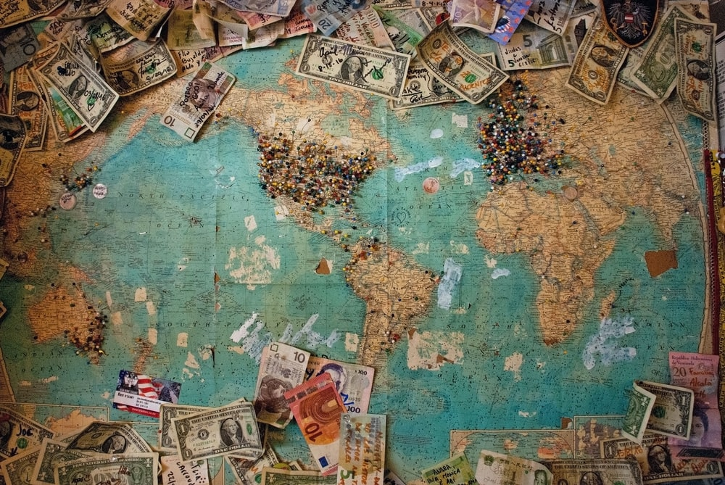
Can money buy happiness
Project Group Members ~ Salina Fambro, Rachel Newberry, Madhusudan tamrakar, Donia Tarjam

Slide 2


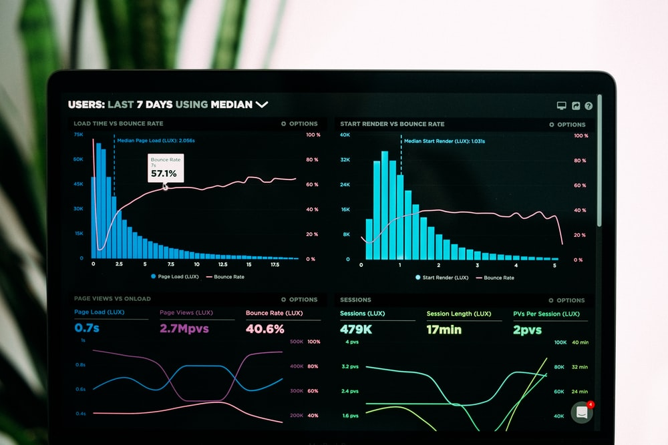
Motivation & Summary
Can money buy happiness
Hypothesis
Motivation
Findings
The differences in happiness levels in socialist versus capitalist countries. Does socialism and capitalism influence a country’s happiness level?

Slide 3

QUESTIONS & EXPLORATION OF DATA
Can money buy happiness
Questions to be answered:
Which attributes are the most important for socialism versus capitalist countries?
Do the most important attributes of happiness change based on quartile groupings?
How did the characteristics rank in each quartile?
How does each characteristic change year over year for the happiest country in the world for both socialist versus capitalist countries?
Will the things that influence happiness change in the future?
Will the top happiest countries in the world change in the years to come?
Here’s where to find the information:
World Happiness Report
Economic Freedom Report
Repository
Donia
Tarjam

Slide 4
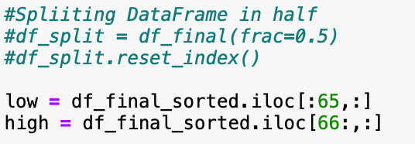

Data cleanup & exploration
Can money buy happiness
Exploration and Cleanup Process & Insights
Jupyter Notebook
Create pathway for the csv files.
Read the csv files into a Data Frame
Merge the different years of data based on the Country column
Merge the years of data with World Happiness Score Dataset
Add suffix to the Contributing Factors column to indicate which year’s data they represent.
Creating a new Data Frame with only the relevant columns (existing in all the datasets)
Get a count of all the rows for each column to ensure there are no missing values
Get the median of the value for the column in which the value is missing. (Median was chosen to ensure the value is not skewed due to outlier values present)
Assign the median to the record with missing value
Check value counts to ensure the missing value has been replaced with the median value
Madhu
Tamrakar

Slide 5
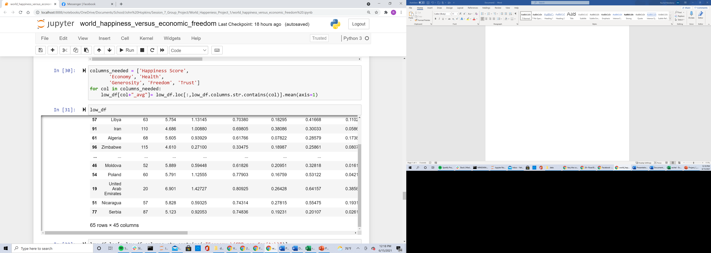
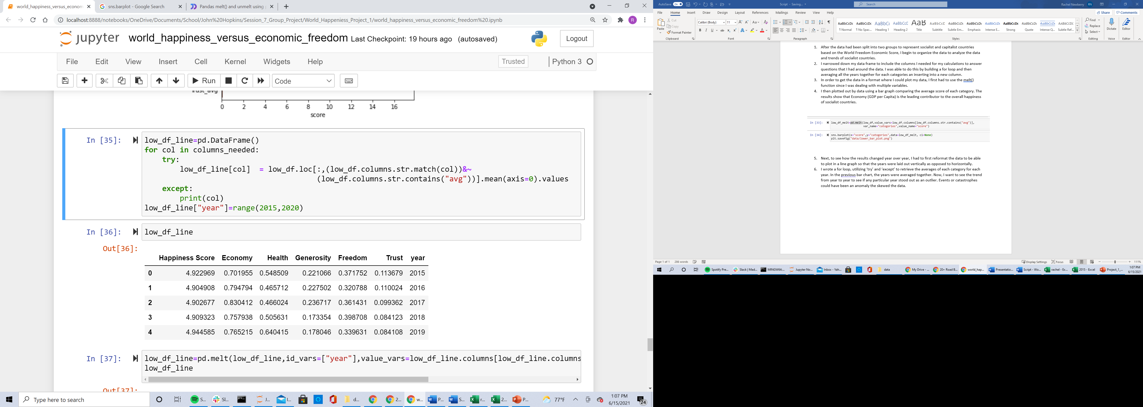
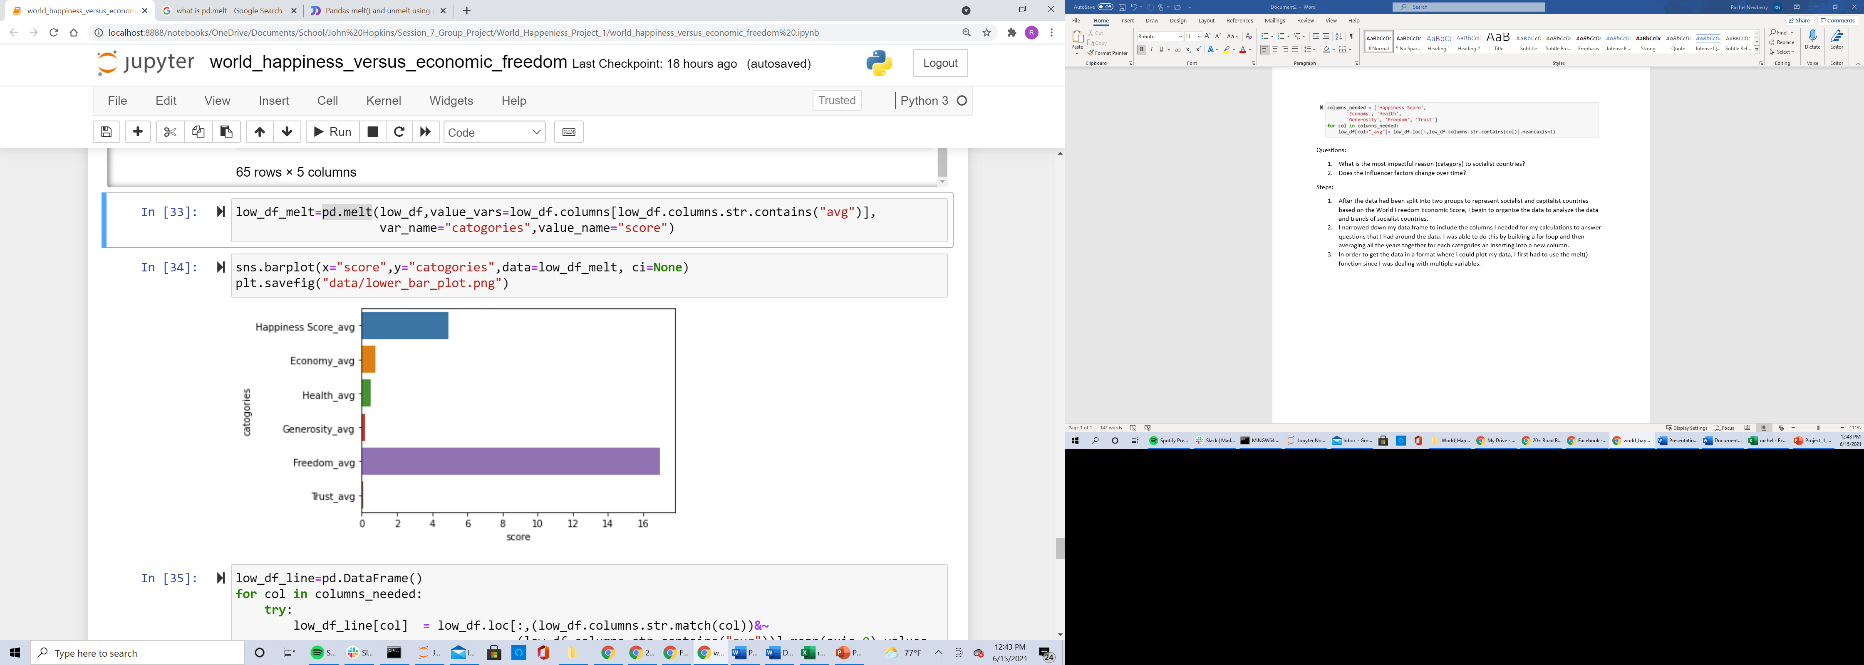
Data analysis & Discussion
Can money buy happiness
Data Analysis
Discussion

Slide 6
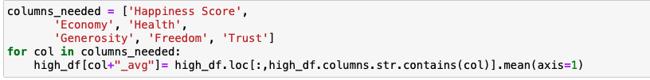
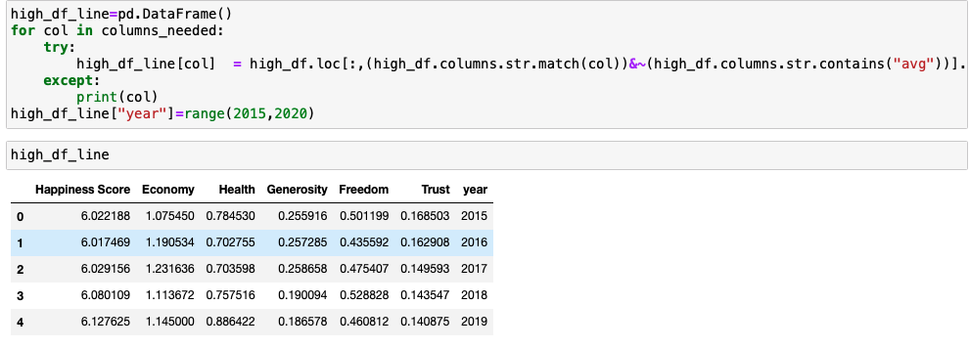
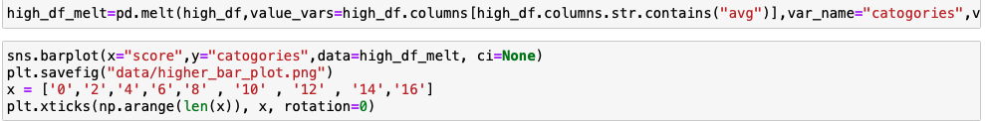
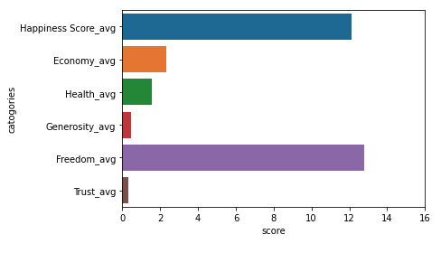
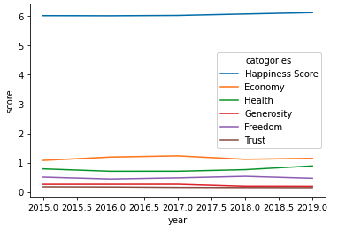
DATA ANALYSIS & DISCUSSION
Can money buy happiness
Data Analysis
Discussion
Higher Economic Freedom Countries Happiness influencer Mix
Higher Economic Freedom Countries Happiness Influencer trends

Slide 7
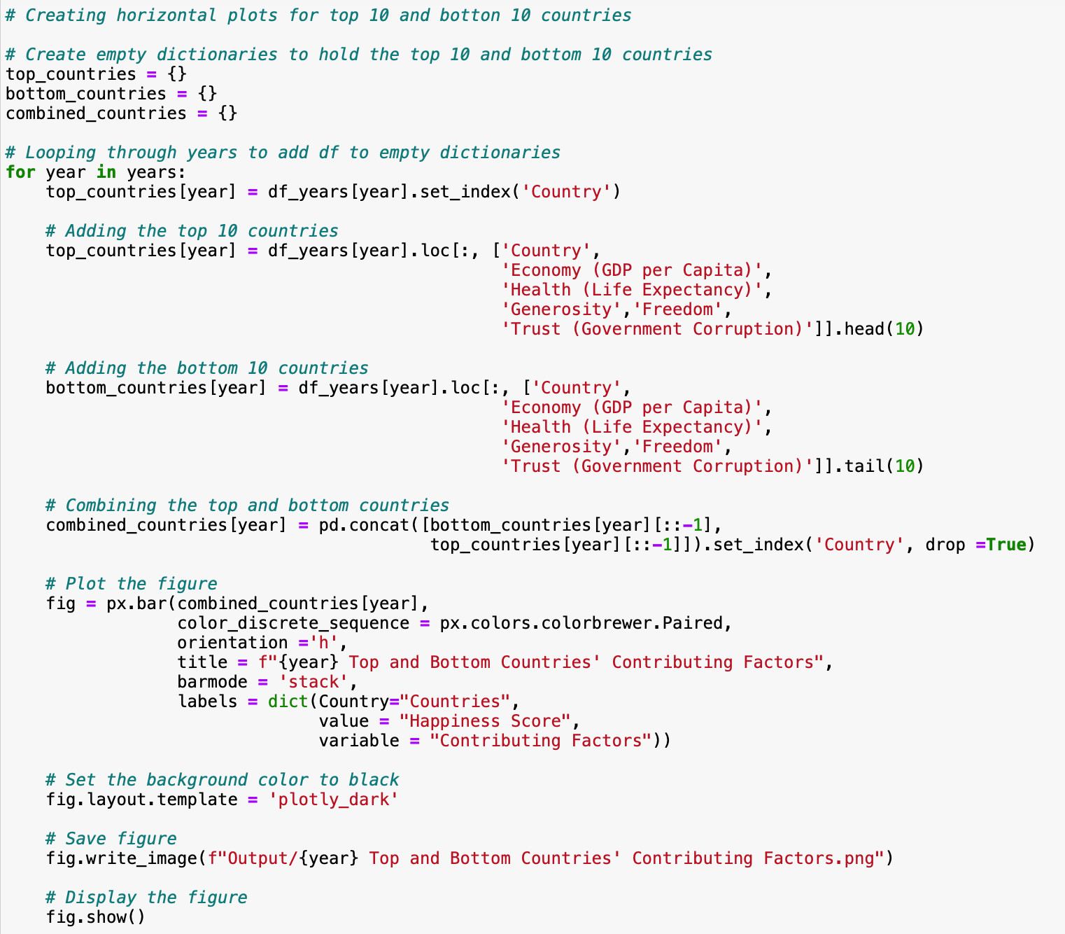
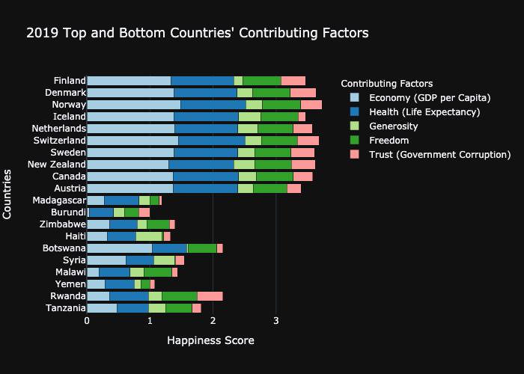
DATA ANALYSIS & DISCUSSION
Can money buy happiness
Data Analysis
Discussion
What is the biggest contributing factors for the top 10 and bottom 10 countries?
GDP > Health > Freedom

Slide 8
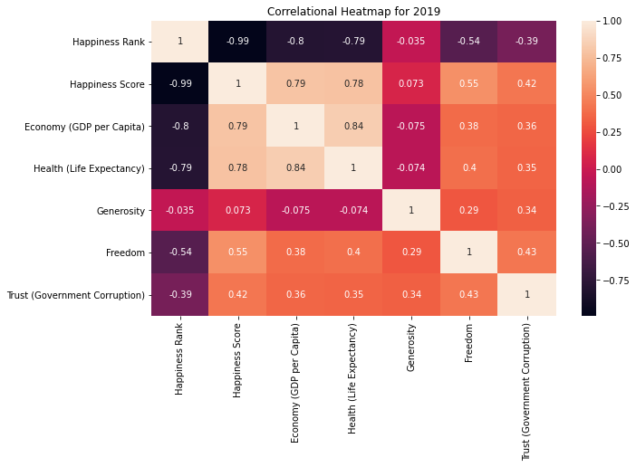
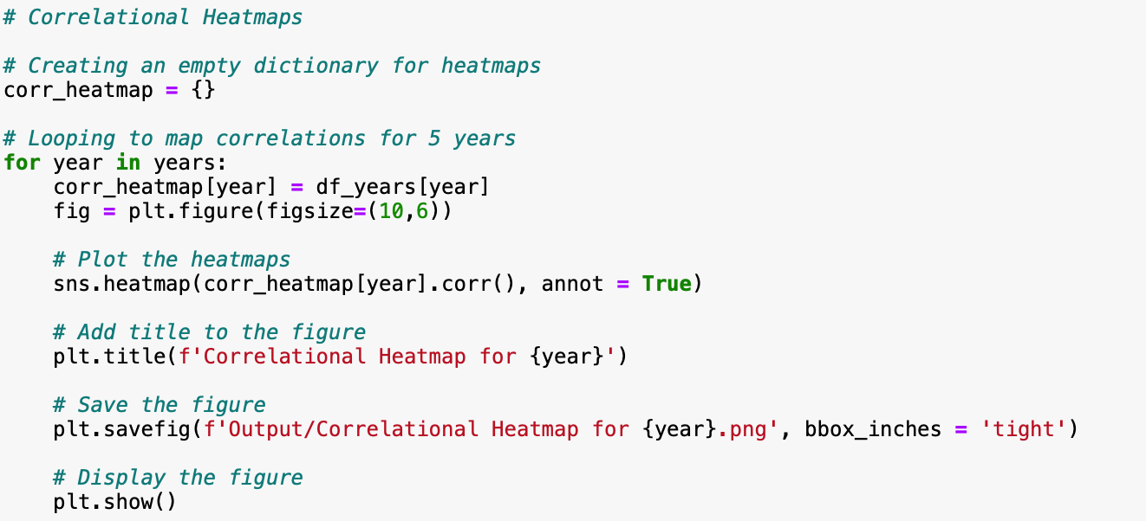
DATA ANALYSIS & DISCUSSION
Can money buy happiness
Data Analysis
Discussion
Which contributing factors have the highest correlation with the happiness of the country?
Consistently from 2015- 2019 it has been Economy and Health

Slide 9
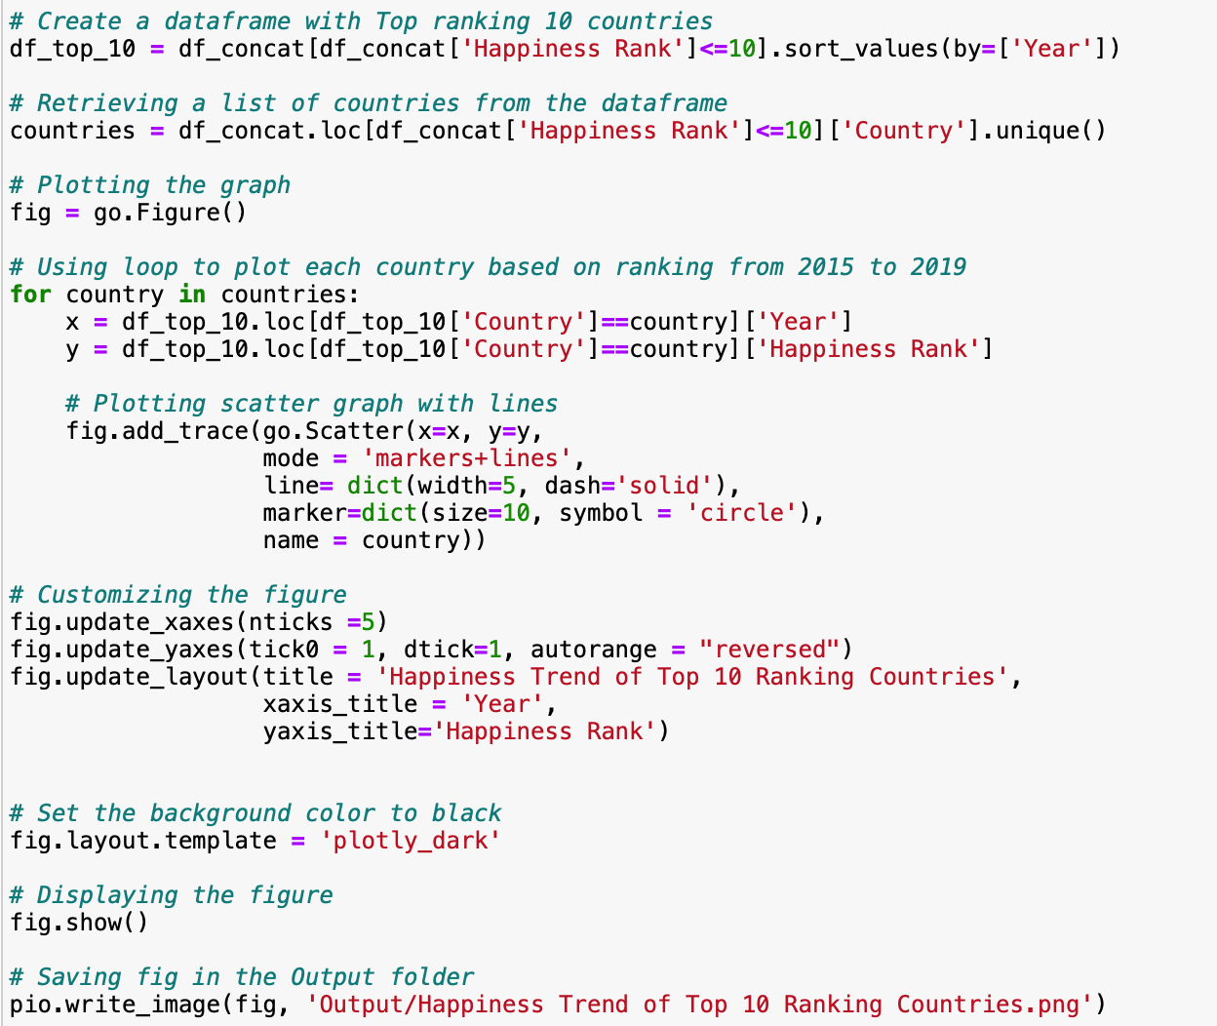
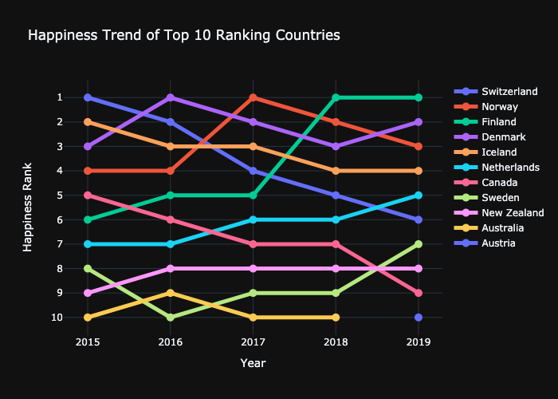
DATA ANALYSIS & DISCUSSION
Can money buy happiness
Data Analysis
Discussion
Which regions have the happiest countries in the world?
-North European countries> North American country, and Australia

Slide 10






POSTMORTEM
Can money buy happiness
Challenges
Merging the data
Missing values
Bucketing Capitalist & Socialist countries bucket
Solutions
Applied median data
Economic Freedom Ranking
Further Research
Prediction modeling
Exploring trends within each happiness influencer category
Group
Notes:
Socialst versus capitalist reporting
prediction modeling

Slide 11


Questions & Answers
The one thing more important than money is the freedom to live life in your own way.

